Slide 1
Full-Stack Web Development Lecture 11: Everything Else… Ashley Williams Ashley.Williams@mmu.ac.uk

Slide 2
Ok, not everything…but some other stuff…
Code Quality Recap
OWASP threats and security
A little bit of DevOps
Assignment/Xmas/Asking good questions
Closing words

Slide 3
Unit Overview
# | W/C | Lecture | Lab
1 | 03/10/2022 | Introduction to Full-Stack | Recap/RESTful APIs
2 | 10/10/2022 | Introduction to NodeJS/ExpressJS | Getting started with NodeJS/ExpressJS
3 | 17/10/2022 | Interacting with Databases | Interacting with Databases
4 | 24/10/2022 | Handling Authentication | Handling Authentication
5 | 31/10/2022 | Version Control | Assignment Support: Backend
6 | 07/11/2022 | API Security and Scaling | Assignment Support: Backend
7 | 14/11/2022 | Introduction to VueJS | VueJS Basics
8 | 21/11/2022 | Networking | Handling API requests
9 | 28/11/2022 | Style, Layout, and Navigation | Layout and Navigation
10 | 05/12/2022 | Code Quality, Structuring and Refactoring | Assignment Support: Front-end
11 | 12/12/2022 | Everything Else! | Assignment Support: Front-end

Slide 4
Where are we up to?
Back-end complete?
Back-end extension?
Front-end functionality?
Front-end looking bootiful?
Front-end extension?
Assignment: functionality 75%; style 15%; extensions 10%

Slide 5
Recap: Code Quality
What is a code smell?

Slide 6
Code Smells
Code that indicates a violation of fundamental design principles are called code smells.
Smells are not bugs in that the application still works as desired. However, they indicate weakness in design that can slow down development and increase the likelihood of future bugs.
Increase technical debt
Source: https://en.wikipedia.org/wiki/Code_smell

Slide 7
Code Smells – Application level
Duplicated Code
Contrived complexity: using overcomplicated design where a simpler design would work
Shotgun surgery: single change needs making on multiple classes
Uncontrollable side effects

Slide 8
Code Smells – Class level
Large class (God class)
Feature envy: using features from another class a lot
Inappropriate intimacy (Object Orgy): a class that has dependencies on the implementation details of another class
Lazy class/freeloader: a class that does too little
Excessive use of literals
Data clump: occurs when a group of variables are passed around together in various parts (should probably be an object)

Slide 9
Code Smells – Method level
Too many parameters
Too long
Excessively long/short identifiers
Too many comments
Excessively long line of code (God line)

Slide 10
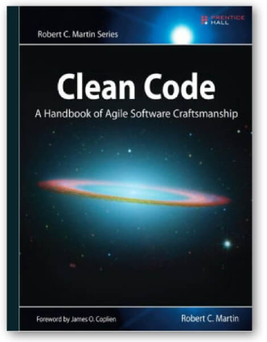
But how do I write cleaner code?
Robert Martin (Uncle Bob)
Developed many SE design principles
One of the Agile manifesto founders
Lecture series on YouTube for some winter watching: https://www.youtube.com/watch?v=7EmboKQH8lM

Slide 11
OWASP Security Threats
OWASP Top 10: https://owasp.org/www-project-top-ten/
“a standard awareness document for developers and web application security”
“Globally recognized by developers as the first step towards more secure coding.”

Slide 12
OWASP Top 10 (2021 list)
FSD?
Broken access control – Restrictions aren’t properly enforced
Sensitive data exposure – data isn’t secure allowing easy access to others (e.g. a lack of encryption)
Injection – sending untrusted data as part of a command/query (also includes cross-site scripting)
Insecure Design – risks relating to design flaws (more use of threat modelling, secure design patterns, reference architectures)
Security Misconfigurations – with highly configurable software, there is lots of room for mistakes
Vulnerable and outdated components – old code, not regularly tested leads to issues
Identification and authentication failures - application doesn’t implement auth and sessions correctly
Software and data integrity failures – making assumptions related to updates, critical data, and CI/CD pipelines without verifying integrity
Security logging and monitoring failures – failures here can directly impact visibility, incident alerting, and forensics
Server Side request forgery – fetching a remote resource, without validating the user supplied URL.
1
2
3
4
5
6
7
8
9
10

Slide 13
What can you do?
Educate yourself on risks/threats and best practices
https://github.com/OWASP/NodeGoat
Scan applications with security audit software
(e.g. Fortify, Hp WebInspect)
Use third party tools
E.g., authenticate with Google, FB, GitHub
E.g., data store with Firebase, AWS
Code review, test, maintain – even after deployment

Slide 14
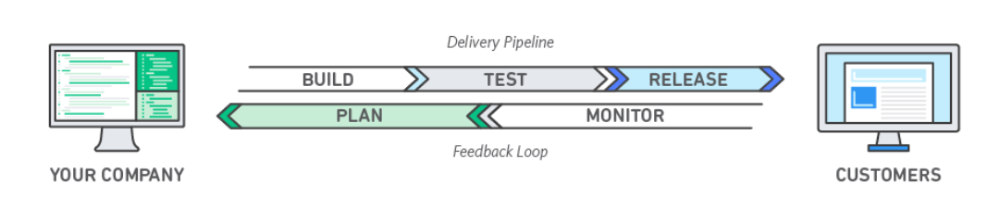
DevOps
“DevOps is the combination of cultural philosophies, practices, and tools that increases an organization’s ability to deliver applications and services at high velocity: evolving and improving products at a faster pace than organizations using traditional software development and infrastructure management processes. This speed enables organizations to better serve their customers and compete more effectively in the market.” - https://aws.amazon.com/devops/what-is-devops/

Slide 15
Continuous Integration (CI)
Practice where developers integrate code into a shared repository frequently. Each integration can be verified by an automated build and automated tests.
Automated testing is technically not part of CI, but normally implied.
“Continuous Integration doesn’t get rid of bugs, but it does make them dramatically easier to find and remove.” - Martin Fowler, ThoughtWorks

Slide 16
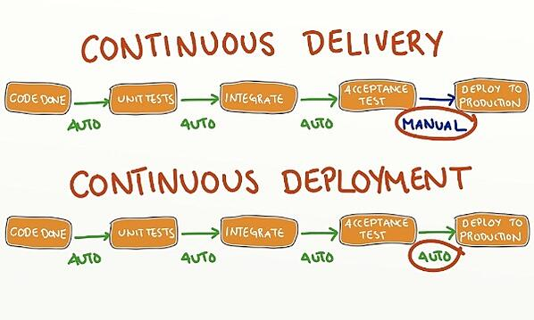
Continuous Delivery (CD)
Automatically deploy application to test/production environments if all automated tests pass
Delivery – keep codebase deployable at any point

Slide 17
CI/CD
Some good videos (more winter watching), both by the same guy at IBM:
CI (6mins): https://www.youtube.com/watch?v=1er2cjUq1UI&ab_channel=IBMTechnology
CD (5 mins): https://www.youtube.com/watch?v=LNLKZ4Rvk8w&ab_channel=IBMTechnology

Slide 18
Assignment

Slide 19
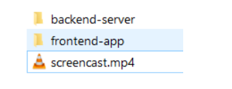
Assignment Submission
Due on Friday the 20th of January @ 9pm
A single ZIP file, containing:
A directory for your backend application
A directory for your front end application
A 5 minute screencast

Slide 20
But Moodle won’t let me upload anything over 100MB
Delete your “node_modules” directories
Make sure you don’t have copies of your code duplicated inside of itself
E.g. back-end-server
All the code
Back-end-server
All the code again
Make sure you record your screencasts as MP4 (no WMV files, we’re not filming a movie)
“It’s still too big” – 99 out of 100 times it will be because you’ve not followed the above steps. It’s only a little app.

Slide 21
But Moodle won’t let me upload anything over 100MB
“No seriously, it’s still too big and I’ve done everything you’ve asked”
Upload your zip to your OneDrive account
Share it publicly
Upload a zip to moodle containing a txt file with the link (moodle will only allow zips)
Don’t edit anything after you’ve submitted, I’ll use the timestamps to ensure nothing has changed
Remember: Large files will take time to upload – and Moodle/the University is strict on deadlines

Slide 22
Recording your screencast
There’s lots of free software, I like OBS because its free and easy
I want to see you run through all of your front-end application (every end-point), and your extensions
Talk me through it – talking me through it allows me to see how you’ve justified design decisions
It’s assessed, and required. No screencast means a heavy penalty
Record it like this ->
Browser
Server terminal window
Front-end terminal window

Slide 23
Don’t forget about your UX
A style framework alone doesn’t mean top marks for UI/UX
Does it validate input on the front-end?
Does it fail with a descriptive error? (e.g. not “Something went wrong”)
Does it help the user or frustrate the user?
Does the layout make sense and feel natural?
Does it allow me to do everything that I should be able to do?
(Remember that you’re coding to a specification – it’s not your job to be making decisions around functionality/security)

Slide 24
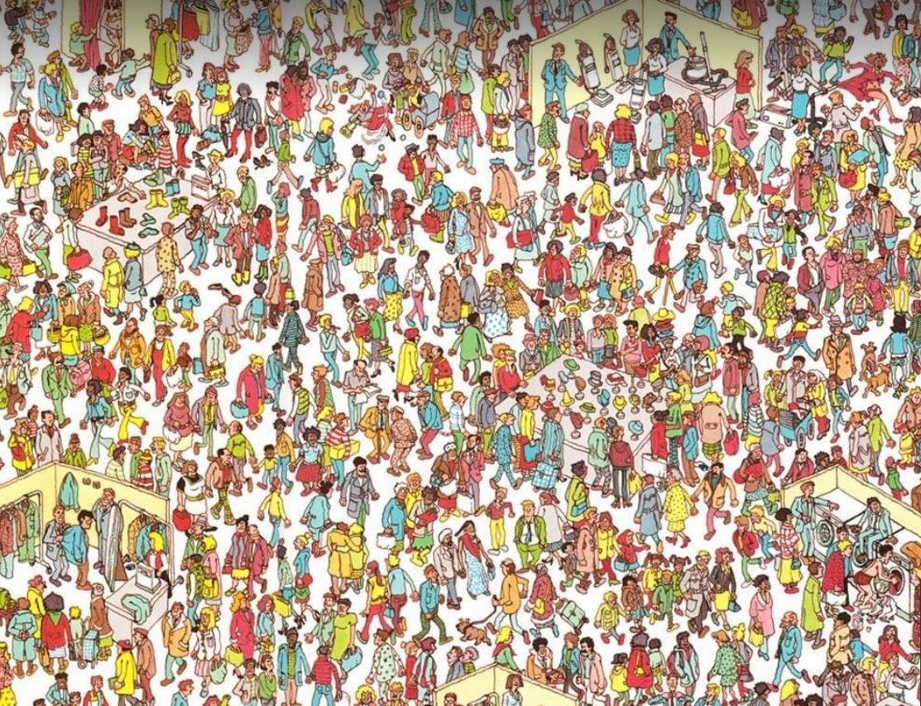
Where’s Ash?
I’m on me holidays…
…I’ll be back on the 5th…

Slide 25
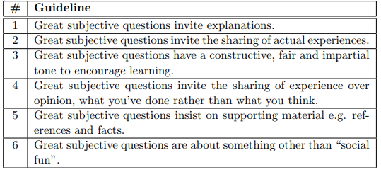
Asking Good Questions
I’m expecting to come back to a tonne of questions, so some guidelines to writing good questions
Robert Cartaino (ex Community Coordinator Stack Overflow) - https://stackoverflow.blog/2010/09/29/good-subjective-bad-subjective/
Send questions over email, include screenshots of the issue, the terminal, and the error.
Expect a reply no later than early into w/c 9th January

Slide 26
Closing words
I hope you’ve enjoyed the unit – feedback is most appreciated!
End-of-unit Survey
My survey – future of SE in HE…
Have a nice break!
Also, have a nice rest of your course??

Slide 27
Questions?
</FullStack>

